Slide 1
Floats: Old-School Layouts
CTEC 130

Slide 2
The History of Layout
Ancient websites used Tables to organize and position elements on the screen
This is not what tables were built for
This was a nightmare
Layout was “fixed” by separating content and style with CSS
Websites used Float and Positioning values to organize details on a page
These values control the flow of elements on the page
This keeps layout separate from content, but manipulating positioning is very fiddly
New layout tools like FlexBox and Grid are finally widely adopted
These tools make it much easier to do common layout changes
But we’ll talk about these next week.
Float positioning has been the dominant form of layout for over a decade, so you’re going to run into it at some point

Slide 3
Float

Slide 4
The float Property
Possible Values:
left
right
none
inherit

Slide 5
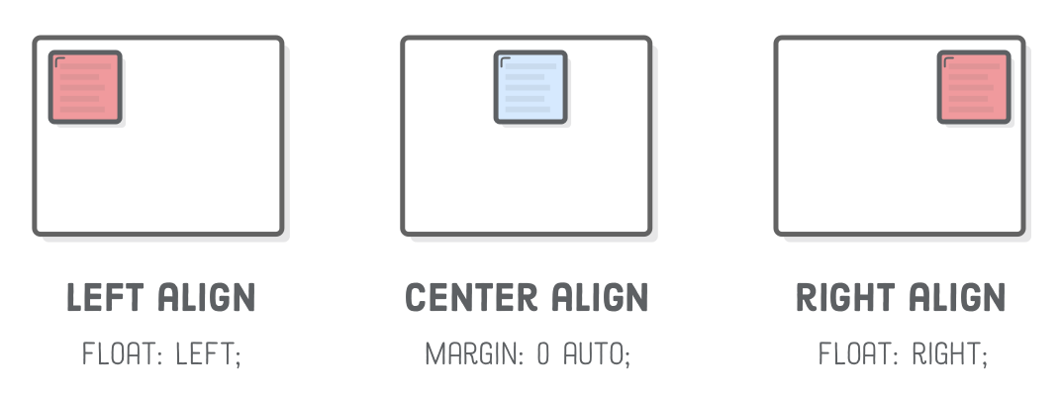
Basic Alignment How-To

Slide 6
The clear Property
Forces a break after a floating element
Possible Values
none
left
right
both
inherit

Slide 7
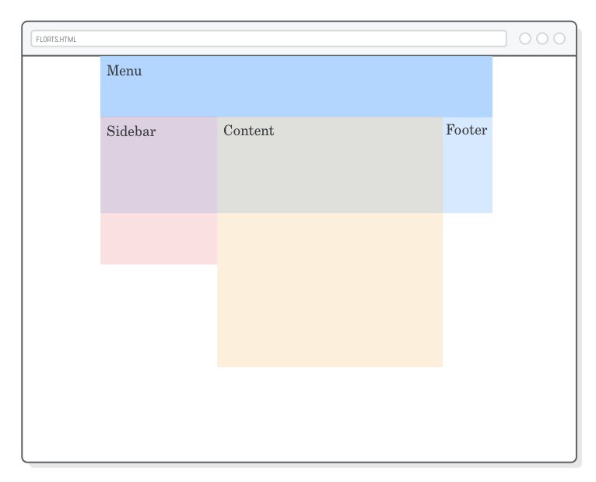
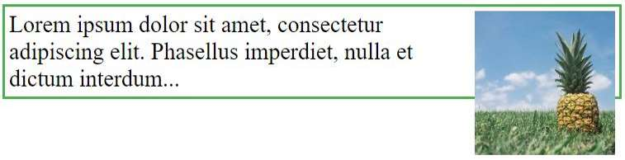
Heights and Clearfix
When an item is floated, it’s “removed” from the normal flow of the page
Elements that should be below a floated element may be alongside them
Floated elements may break the boundaries of outer elements

Slide 8
Clearfix
Floats often lead to unintended consequences
Here are a few fixes:
clear: both - setting clear can sometimes fix basic issues
overflow: hidden - this forces a box to recognize the size of anything inside of it
Overflow is usually used to define how to handle when content is too big to fit into a defined size
Values:
visible
hidden
scroll
auto

Slide 9
Columns

Slide 10
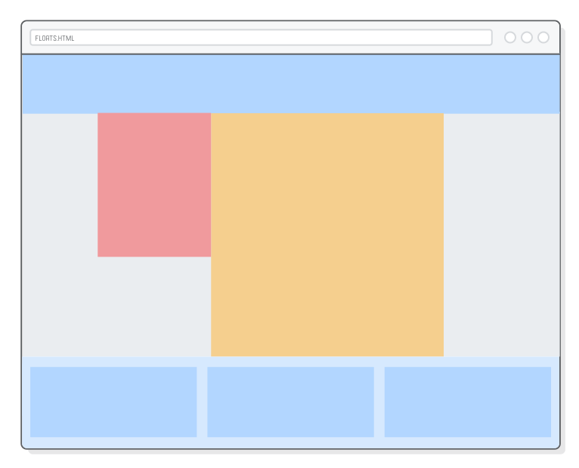
Multi-Column Layout
Was a huge trend in the mid 2000s, but is still commonly used
Breaks content down into multiple blocks to display next to each other

Slide 11
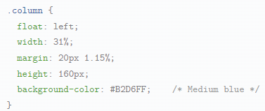
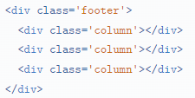
Columns with Float

Slide 12
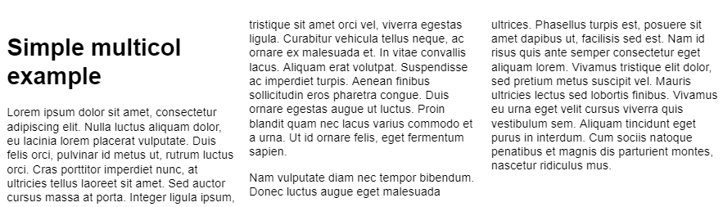

Multi-Column within a single Element
Multi-Column layouts are so popular that they got baked into CSS
You can set the column-count property on an element to automatically break it into a magazine-style layout

Slide 13
Column Specific CSS Properties
column-count
column-width
column-gap
column-rule
Similar to a border, but for a line that goes between columns

Slide 14
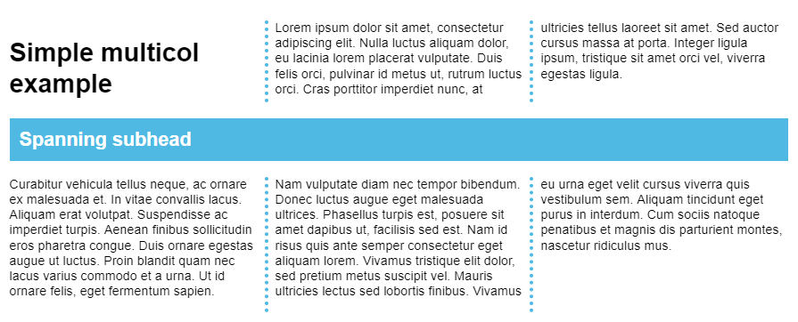
Spanning Columns
Use column-span to make an element break the column flow
Set to all or none
Only works for column properties, not when making columns with float

Slide 15
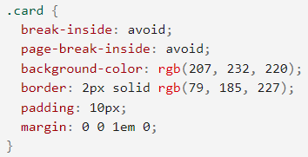
Breaks
Content in a column will flow as if it’s in a normal document
That means you may break a paragraph in half when creating a column
To keep elements together as a whole inside of a column, you can set break-inside

Slide 16
When to use What
Use Float to create columns if:
You’re defining the basic layout of the site
Your content exists in different “boxes”
Use CSS Columns to create columns if:
You want to break a single article into multiple columns
Your content exists in one “box”

Slide 17
Positioning

Slide 18
Positioning
By default, all of the information on a page flows from the top to the bottom like a printed document
But it doesn’t have to
We can set positioning to override where elements appear and create interesting effects
Types of positioning:
Static - the default positioning
Relative - like static, but can be manipulated based on its initial position
Absolute - position is set from the top left origin of the container
Fixed - position is set relative to the viewport
Sticky - a hybrid of relative and fixed

Slide 19
Top, Bottom, Left and Right
Set these properties to move your content based on its positioning

Slide 20
Let’s mess with Positioning

Slide 21
Positioning Contexts
All ancestors are Static by default
If an element is Absolute positioned and all of its ancestors are Static, its position will be Absolute to the browser window
If an ancestor of an Absolute element is Relative or Absolute, its position will be Absolute to that ancestor
You may have to review the ancestor positioning of your elements if your layout doesn’t look like you expect it to

Slide 22
Z-Index
When we mess with positioning, elements often can end up on top of each other
We can set the Z-Index to define which elements should be on top
Higher values are “on top” of lower values

Slide 23
Basic Layout Concepts

Slide 24
Breaking Down a Page
To layout a page, you need to think of the common elements on each page
Navigation, Header, Footer, Posts, etc.
Semantic HTML actually makes this easier to think about
Try to use the same HTML format for the same types of information
Each article should be composed of the same tags in a similar order
Think of what “any” article should look like, write an HTML template for that, and use that template when creating a new article
Do this for comments, navigation, lists, etc.
If you go into back-end web development, programs will usually build websites by combining HTML templates as described above with database information to create each page

